Slide 1

CAPSTONE PROJECT BANK MARKETING EFFECTIVENESS PREDICTION
(SUPERVIED MACHINE LEARNING CLASSIFICATION)
TEAM MEMBERS
Aditya Tadas
Nikhil Machave
Aishwarya Methe

Slide 2

AGENDA
PROBLEM STATEMENT
BUSINESS UNDERSTANDING
FEATURE ANALYSIS
DATA SUMMARY
HANDLING MISSING AND DUPLICATE VALUES
UNIVARIENT ANALYSIS
BIVARIENT AND MULTIVARIENT ANALYSIS
FEATURE ENGINEERING
FEATURE SELECTION
FREQUENCY COUNT ENCODING AND ONE HOT ENCODING
FINDING COVARIENCE OF VARIABLES
HANDLING CLASS IMBALANCE USING SMOTE
SPLITTING DATA INTO TRAIN AND TEST
FITTING CLASSIFICATION MODEL
HYPERTUNING OF BEST FIT MODEL
EXPLAIN FEATURE IMPORTANCE USING SHAPASH MODEL EXPLANATORY
CONCLUSION

Slide 3
PROBLEM STATEMENT
The data is related with direct marketing campaigns(phone calls) of a Portuguese banking institution.
The marketing campaigns were based on phone calls often, more than one contact to the same client was required, in order to access if the product (bank term deposit)would be(yes) or not(no)subscribed.
The classification goal is to predict if the client will subscribe a term deposit (variable )

Slide 4
BUSINESS UNDERSTANDING
Bank marketing is the design structure, layout and delivery of customer-needed Services worked out by checking out the corporate objectives of the bank and environmental constraints.
A term deposit is fixed-term investment that include the deposit of money into an account at financial institution. Term deposit investments usually carry short-term maturities ranging from one month to a few years and will have varying levels of required minimum deposits.
The investor must understand when buying a term deposit that they can withdraw their funds only after the term ends. In some cases ,the account holder may allow the investor early termination or withdrawal if they give several days notification .Also, there will be a penalty assessed for early termination.

Slide 5
FEATURE ANALYSIS
Age:(numeric)(Age of the person)
Job: type of job (categorical: ’admin’, ‘blue-collar', entrepreneur’ , housemaid’,’management’,’retired’,self-employed’,services’,’student’,’technician,’’unemployed’,’unknown’)
Marital: marital status(categorical:’ divorced’, ’married’,’ single ’,unknown’ note divorced means divorced or windowed)
Education: categorial:basic.4y,basic.6y,basic.9y,’high school, ’illiterate’, professional course', university degree', 'unknown’
Default: has credit in default?(categorical: ’no’, yes, unknown’)
Housing: has housing loan?( categorical: ’no ’yes, unknown’)
Loan: has personal loan(categorical: no, yes unknown’) retained with the last contact of the current campaigns:
Contact: contact communication type(categorical:’ cellular, telephone’)
Month: last contact month of year (categorical: jan, feb, mar, nov , dec)
Campaign: number of contacts performed during this campaign and for this client (numeric, includes )
duration: last contact duration in seconds (numeric).Important note: this attribute highly affected the output
Target(if duration=0 then y= no) Yet the duration is not known before a call is performed. Also ,after the end of the call y is obvious known thus this input should only be included for benchmark purposes and should be discarded if the intension is to have a realistic predictive model
Pdays: number of days that passed by after the client was last contacted from a previous campaign (numeric;999 means client was not previously contacted)
Previous: number of contacts performed before this campaign and for this client (numeric)
Balance: (numeric) account balance of this client
Day: (numeric) day of the week
Poutcome: outcome of the previous marketing campaign (categorical: failure non existent success social and economic context attributes
Y: has the client subscribed a term deposits?(binary, yes ,no)

Slide 6
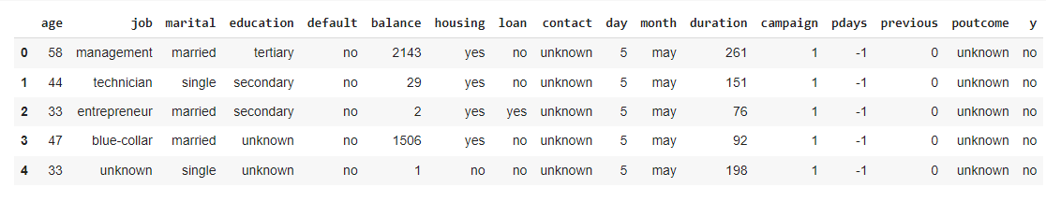
DATA SUMMARY
Here we have summary of our dataset
There are 6 numerical variable present in our dataset i.e age,balance,day,duration,campaign,pdays,previous.
There are 9 categorical variable present in our dataset which are job,marital,education,default,housing,loan,contact,month,poutcome.
Our target variable is Binary class variable i.e ‘y’.

Slide 7
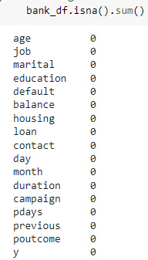


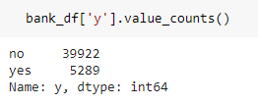
FINDING MISSING AND DUPLICATES VALUES
Data contains 45211 records and 17 columns.
There are no null values present in our dataset.
There are no duplicated value present in our dataset.
As we seen in the column ‘y’ which is out target variable there are very high class imbalance in that column so we have to done some oversampling or Undersampling method to overcome class imbalance problem.

Slide 8
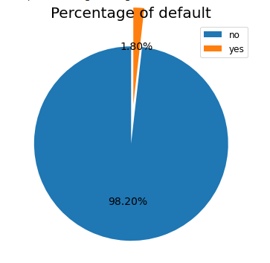
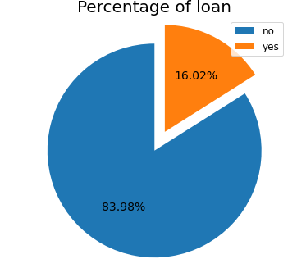
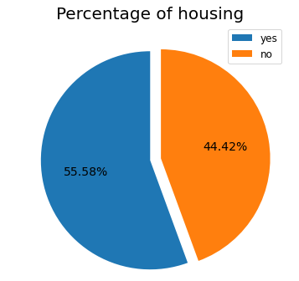
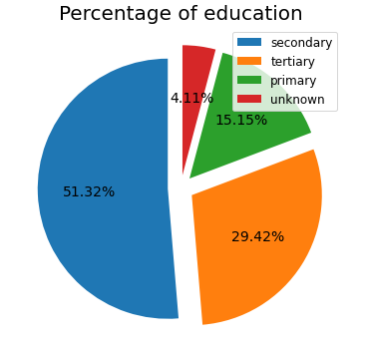
UNIVARIENT ANALYSIS ON CATEGORICAL COLUMNS
As we can see that in the pie plot of percentage of default , Most number of clients in our dataset does not having default , 98.20% of clients have not done any default only 1.80 % clients are default.
In the loan pie plot , 83.98 % clients are not taking any personal long only 16.02 % of clients having personal loan.
In a pie plot of Housing, roughly above 50 % of clients have taken housing loan so we can say that half of the client
taken housing loan.
Among all the clients most of the clients have done secondary education , education of 4.11% of clients is unknown.

Slide 9
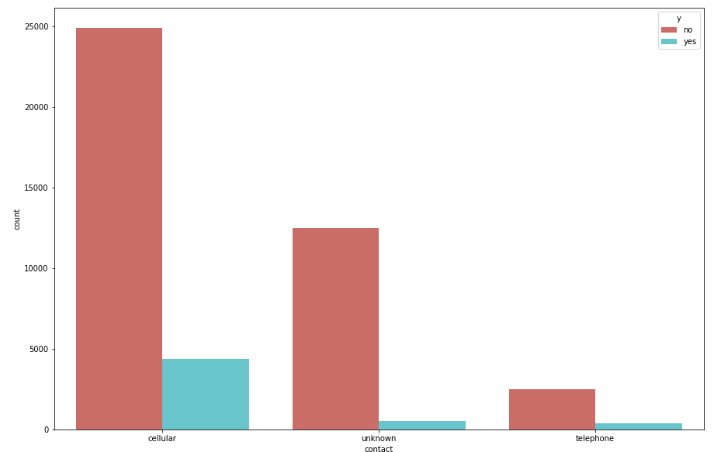
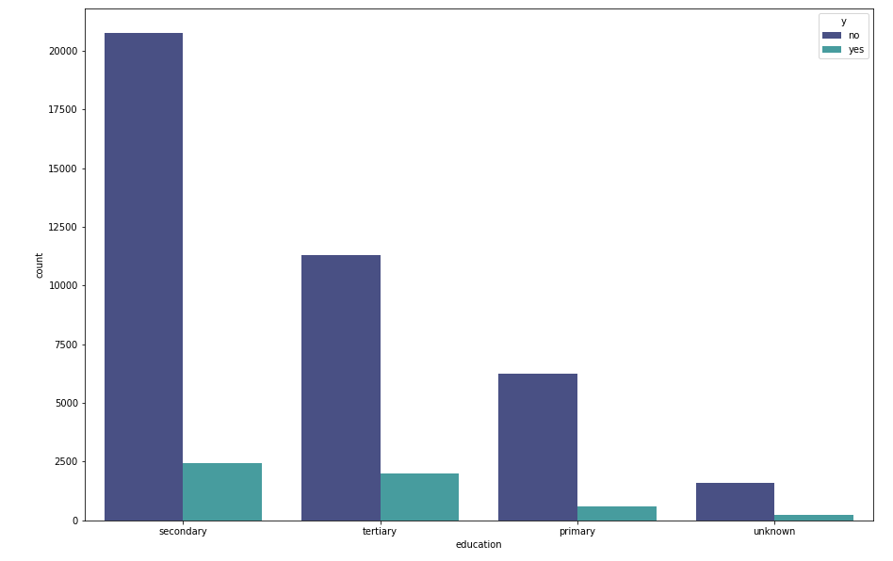
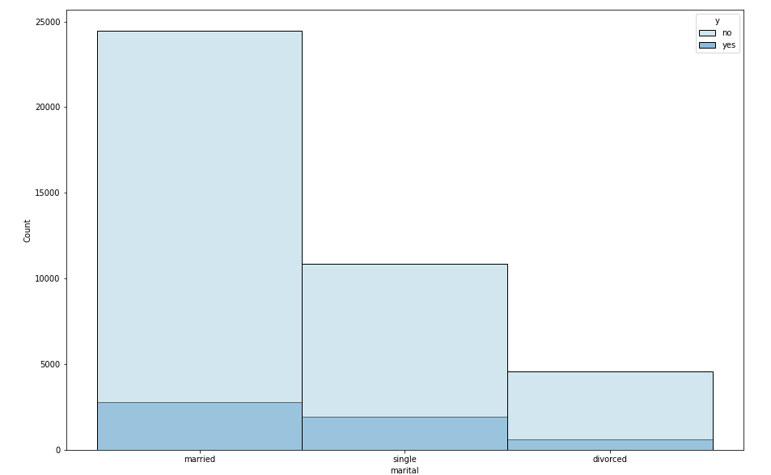
BIVARIENT ANALYSIS ON CATEGORICAL COLUMNS
Most of the clients contacted through cellular after that least clients are contacted through telephone there are some records having unknown contact also.
Most of the clients who contacted through cellular agree to subscribe for the term Deposit, Very less clients which are contacted through telephone agree to subscribe for term deposit.
Most of the clients having education secondary and terittary agree to subscribe for term deposite, very less clients having
primary and unknown education subscribe for term deposit.
Most of the clients who’s marital status is married agree to subscribe for term deposit after that single marital status clients
agree to subscribe for term deposit but when the marital status of client is divorced then those clients have very less possibility to subscribe for term deposite

Slide 10
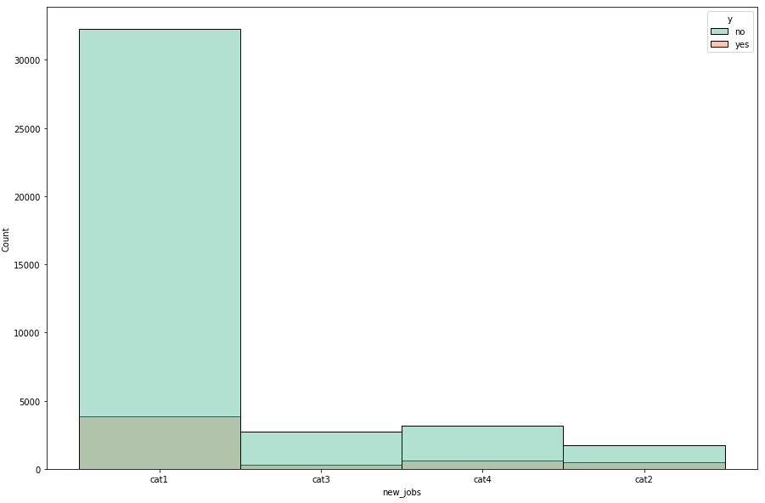
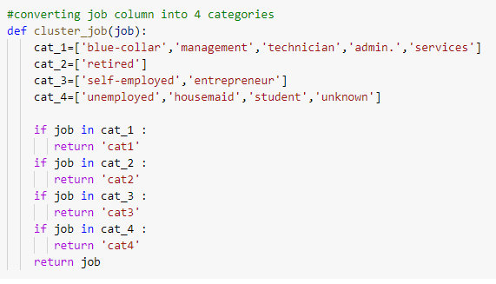
FEATURE ENGINEERING
We have done some feature engineering for job columns we have created 4 categories according to their attributes
Job name blue collar , management , technician , admin and services are grouped as category 1.
Retired client are named as category 2.
Self employed and entrepreneur grouped as category 3.
Unemployed , housemaid , student and unknown are grouped as category 4.
Soo from the above categories we have seen that when the client subscribed for term deposit mostly belonging to category 1.

Slide 11
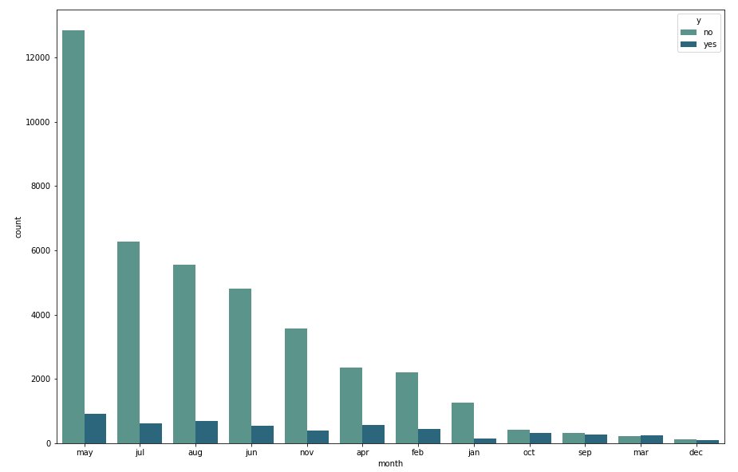
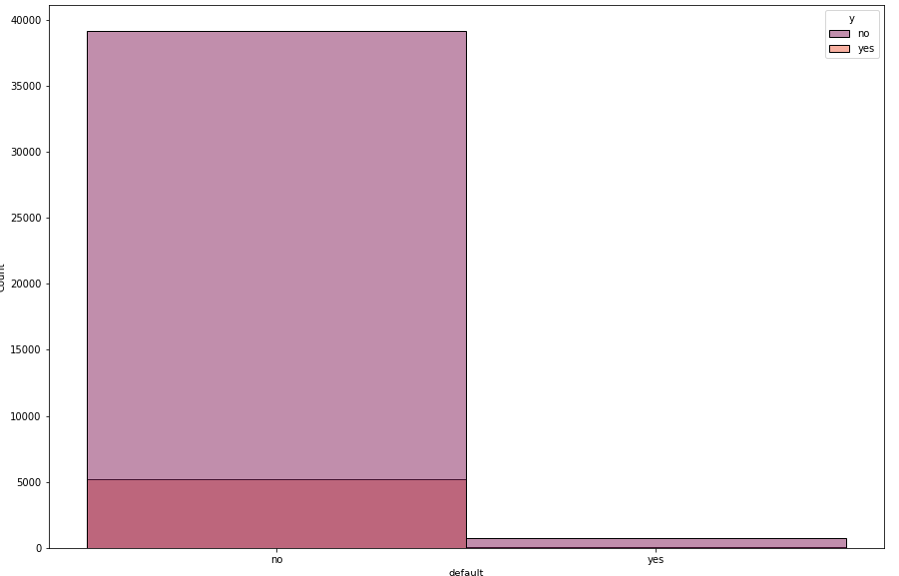
In the month may, jul, aug, jan most of the clients subscribed for term deposit but in the month dec , mar , sep very less clients subscribed for term deposit.
When client not done any default those clients are more likely to subscribe for term deposit.

Slide 12
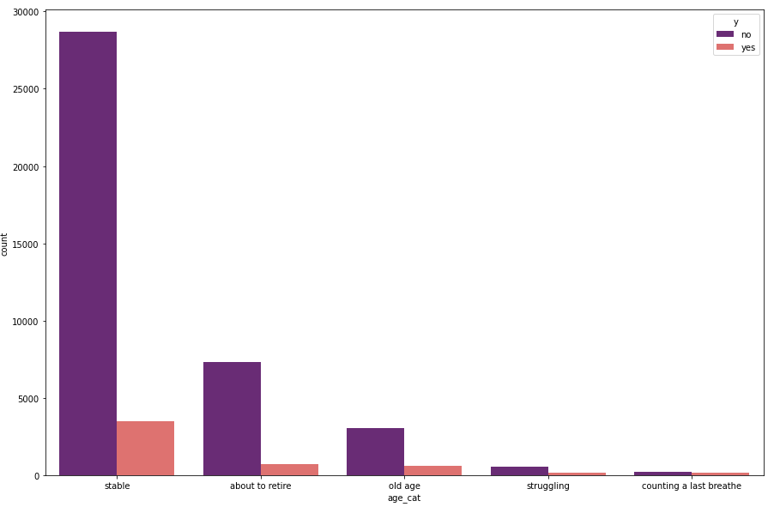
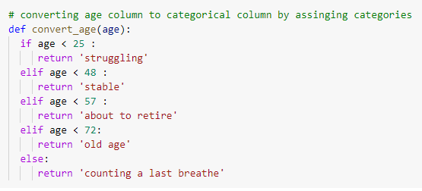
According to the age we have categories age column into 5 categories .
When age of the clients is below 25 they belong to struggling category , when the age of clients is 25-47 and 48-57 they belong to category stable and about to retire respectively.
When the age of the client is 57-72 they belong to old age category after that all are greater than 72 age they belong to counting last breathe category.
So from the above categories we have seen that when the category of client is stable then there is high possibility that those client agree to subscribe for term deposit after that about to retire and old age categories have more possibility.

Slide 13
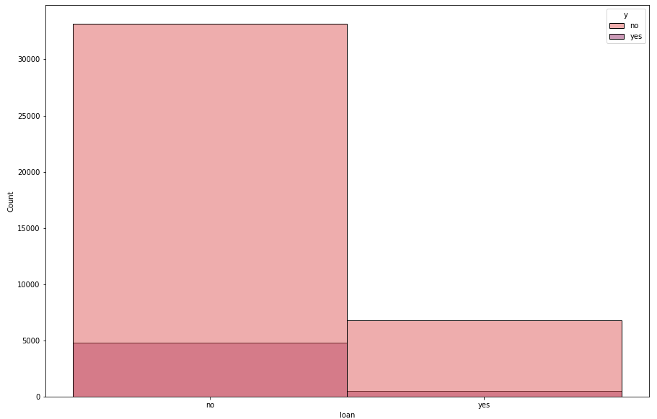
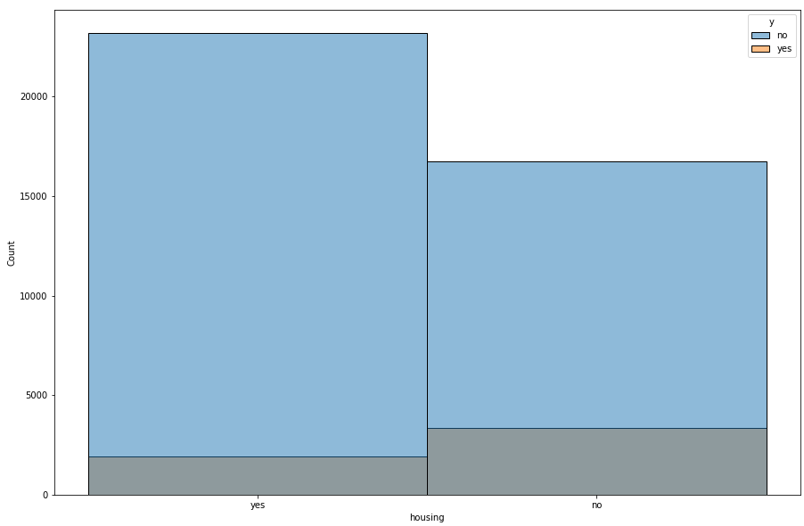
Client who has not having personal loan have high possibility that they agree to subscribe for term deposit but when clients
having personal loan they rarely agree to subscribe for term deposit.
There are somewhat equal possibility that when the client having housing loan or do not having personal loan agree to subscribe for term deposit so we can say that housing loan does not affect much to predict .

Slide 14
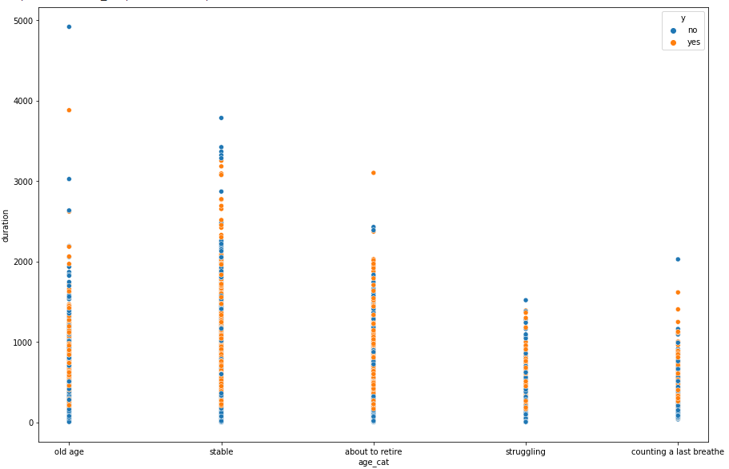
When the age category is old age and stable then communication duration with these age category are higher that’s why
there is high possibility that old age and stable category clients having high possibility to subscribe for term deposit.
When the age categories are struggling and counting last breathe then communication with those clients are less that’s why there is very less possibilty that those categories agree to subscribe for term deposit.

Slide 15
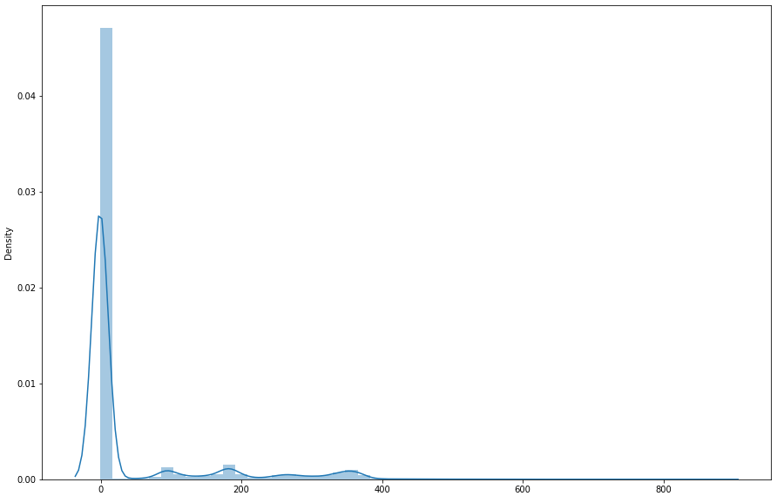
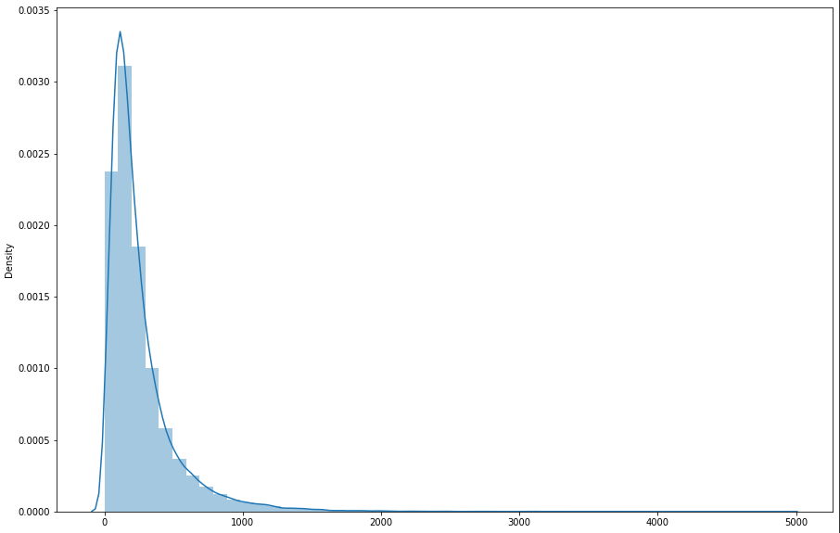
pdays
duration
In pdays columns most the values are zero or below than 0 there are very less value who are above zero and these column contains very big outliers that effects the accuracy of our model also pdays does not affects on prediction of our model Soo we have dropped these column from our dataset.
In the distribution plot of duration Confidance interval tents to zero most of the values are 0 in that columns also in problem statement it is given that we have to drop that column to train our model hence we dropped that columns from our dataset.
Also age and job columns have been also dropped because we extracted other feature by using that columns.

Slide 16
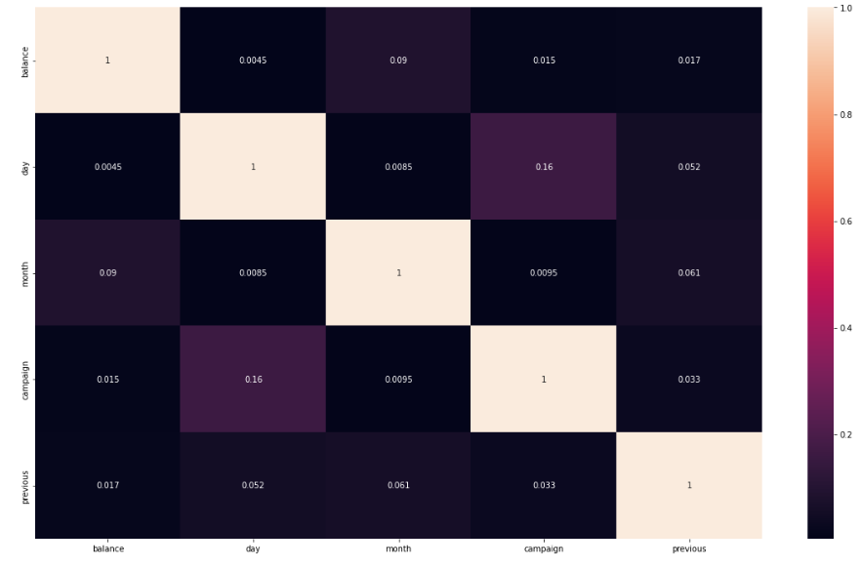
CORRELATION HEATMAP

Slide 17
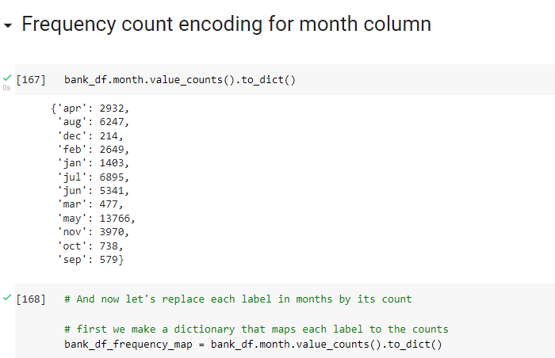
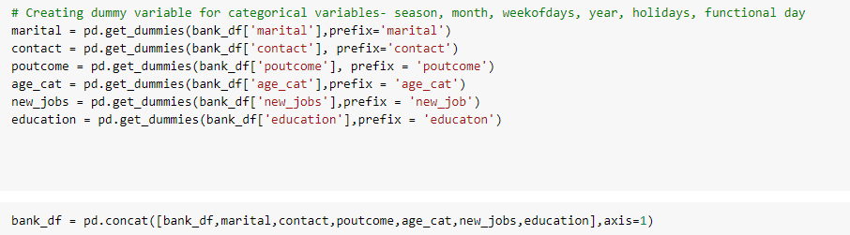

We use frequency count encoding for month variable i.e we assign number to each month according to there counts.
For other variable we have used on hot encoding method are create dummy variable
After that we Seperating our dependent variable and independent variables to train model.

Slide 18
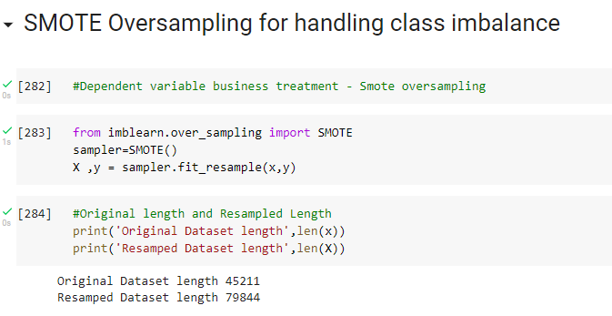
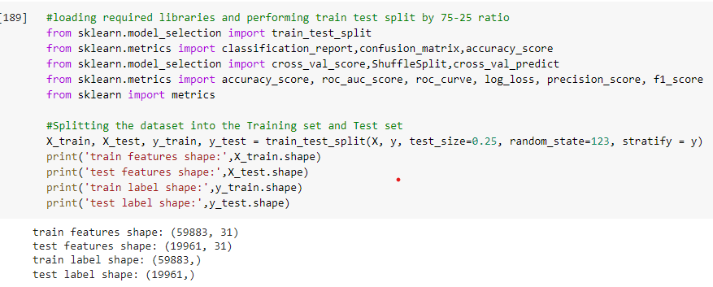
Applying SMOTE sampling to handle class imbalance.
Fit it to our dependent and independent features.
Then applying train test split and split the 75% of data to train and 25% of data to test.

Slide 19
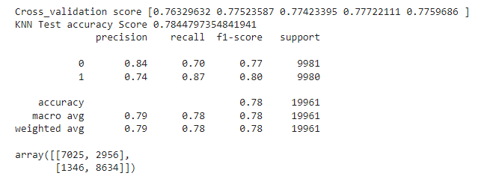
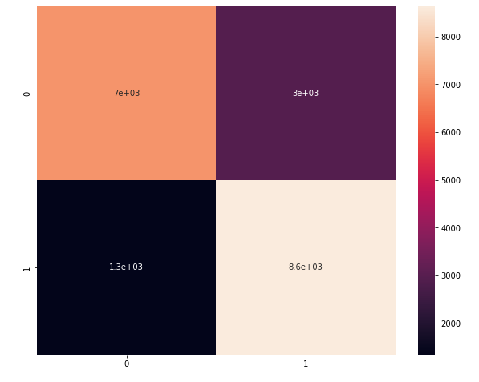
K – NEAREST NEIGHBOUR CLASSIFIER

Slide 20
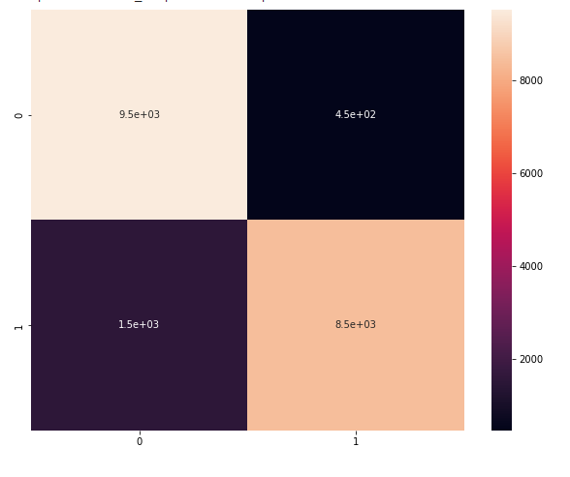
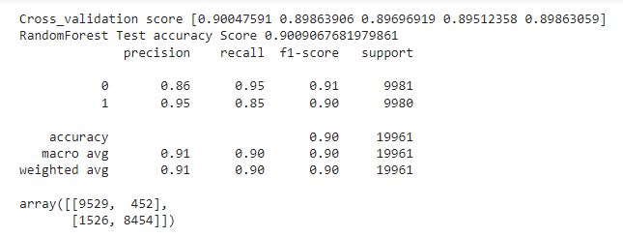
RANDOM FOREST CLASSIFIER

Slide 21
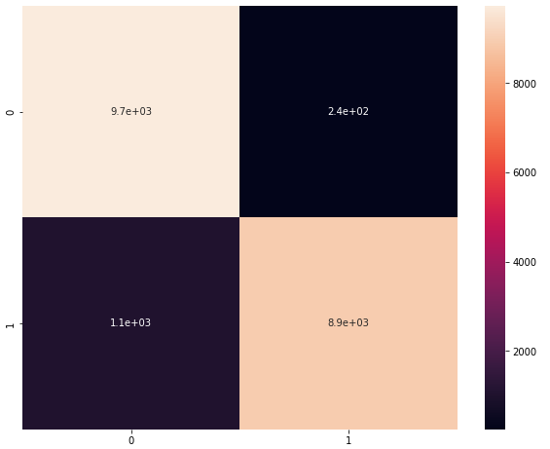
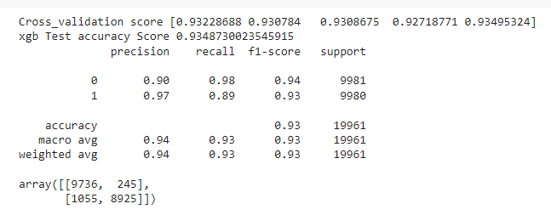
XG BOOST CLASSIFIER

Slide 22
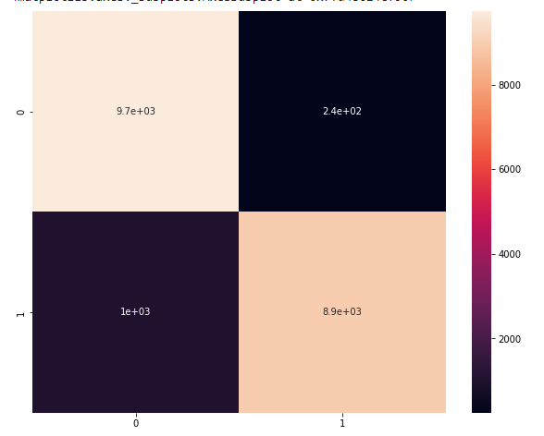
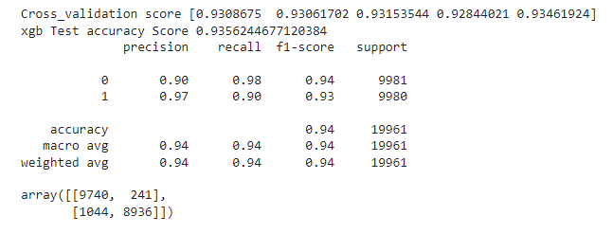
HYPERPARAMETER TUNING OF XG BOOST CLASSIFIER

Slide 23
MODEL AND ITS ACCURACY
SERIAL NO. | MODEL | ACCURACY
1. | K-NEAREST NEIGHBOUR | 0.79
2. | RANDOM FOREST CLASSIFIER | 0.90
3. | XG BOOST CLASSIFIER | 0.93
4. | HYPERPARAMETER TUNING OF XG BOOST CLASSIFIER | 0.94
XG Boost classifier perform best for predicting target variable also we we hypertune XG boost model it will increases
The accuracy of prediction by 1 % .
XG Boost hypertunes classifier gives the accuracy of 94%.

Slide 24

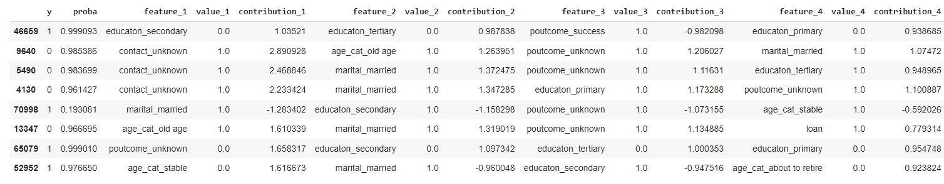
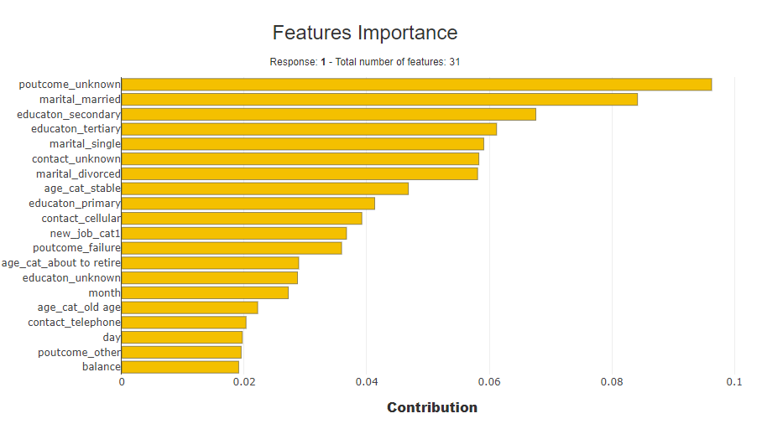
SHAPASH MODEL EXPLANATORY
From the above model explanatory tool we have seen that poutcome
Unknown is the most important feature while predicting our target variable also from the table we can see that when the poutcome is 0 then it contribute in the negative way and increases the probability of predicting 0.
Marital married is the second most important feature for predicting target variables from the table we can see that when the marital married then it will affect positively and increases the probability of predicting 1.
Also age cat stable variable affect positively on the target variable when the age of clients is stable then it will increases the probability of predicting 1 that means it higher the probability that client will subscribe for term deposit.
Also education secondary affects positively on the target variable when the client education is secondary then it increases the probability that client will agree to subscribe for term deposit.

Slide 25
CONCLUSION
From the above project we can conclude that XG boost classifier is the best fit classification model for predicting weather the client agree to subscribe for personal loan or not.
When we Hypertuned these XG Boost classifier the accuracy of the model increases by 1 % So it predicts 94% prediction correctly.
There are some important feature for predicting our target variable we use Shapash model explanatory to explore that features.
We visualize 20 feature which are most important while predicting target variable.
From that feature we conclude that clients age , education ,job and and marital status and outcome of previous campaign are the most important feature for predicting that weather client agree to subscribe for term deposit or not that’s why bank prefer these information to start for new campaign and to target customer.

